Slide 1
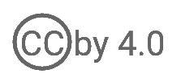
WSO2 API Manager 4.2.0 Developer Advanced
API Manager Branding Extensions
WSO2 Training

Slide 2
Overriding Developer Portal Theme

Slide 3
Overriding Developer Portal Theme
WSO2 provides the developers with an easier approach to customize the UI. You do not need to have React, CSS, or HTML knowledge to customize the UI.
We have a single JSON file which holds the parameterized constraints of the look and feel.
When updating the Developer Portal theme, you can update not only the look and feel, but also behaviors such as making the listing view default instead of grid view, hiding social features, etc.
Overriding the Developer Portal Theme

Slide 4
Overriding the default theme
The default theme defaultTheme.js is located in the <API-M_HOME>/repository/deployment/server/webapps/devportal/src/main/webapp/source/src/app/data/ directory.
The defaultTheme.js file has the parameters defining the look and feel of the Developer Portal.
Using the above file as reference, you can add new properties to userTheme.json located in the <API-M_HOME>/repository/deployment/server/webapps/devportal/site/public/theme/ location.
Changes done in the userTheme.json file are reflected directly in the Developer Portal ( It is not required to restart the server or rebuild the source code).
Overriding the Default Theme

Slide 5
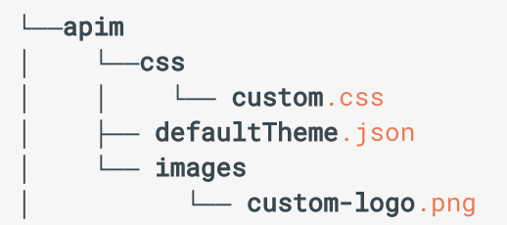
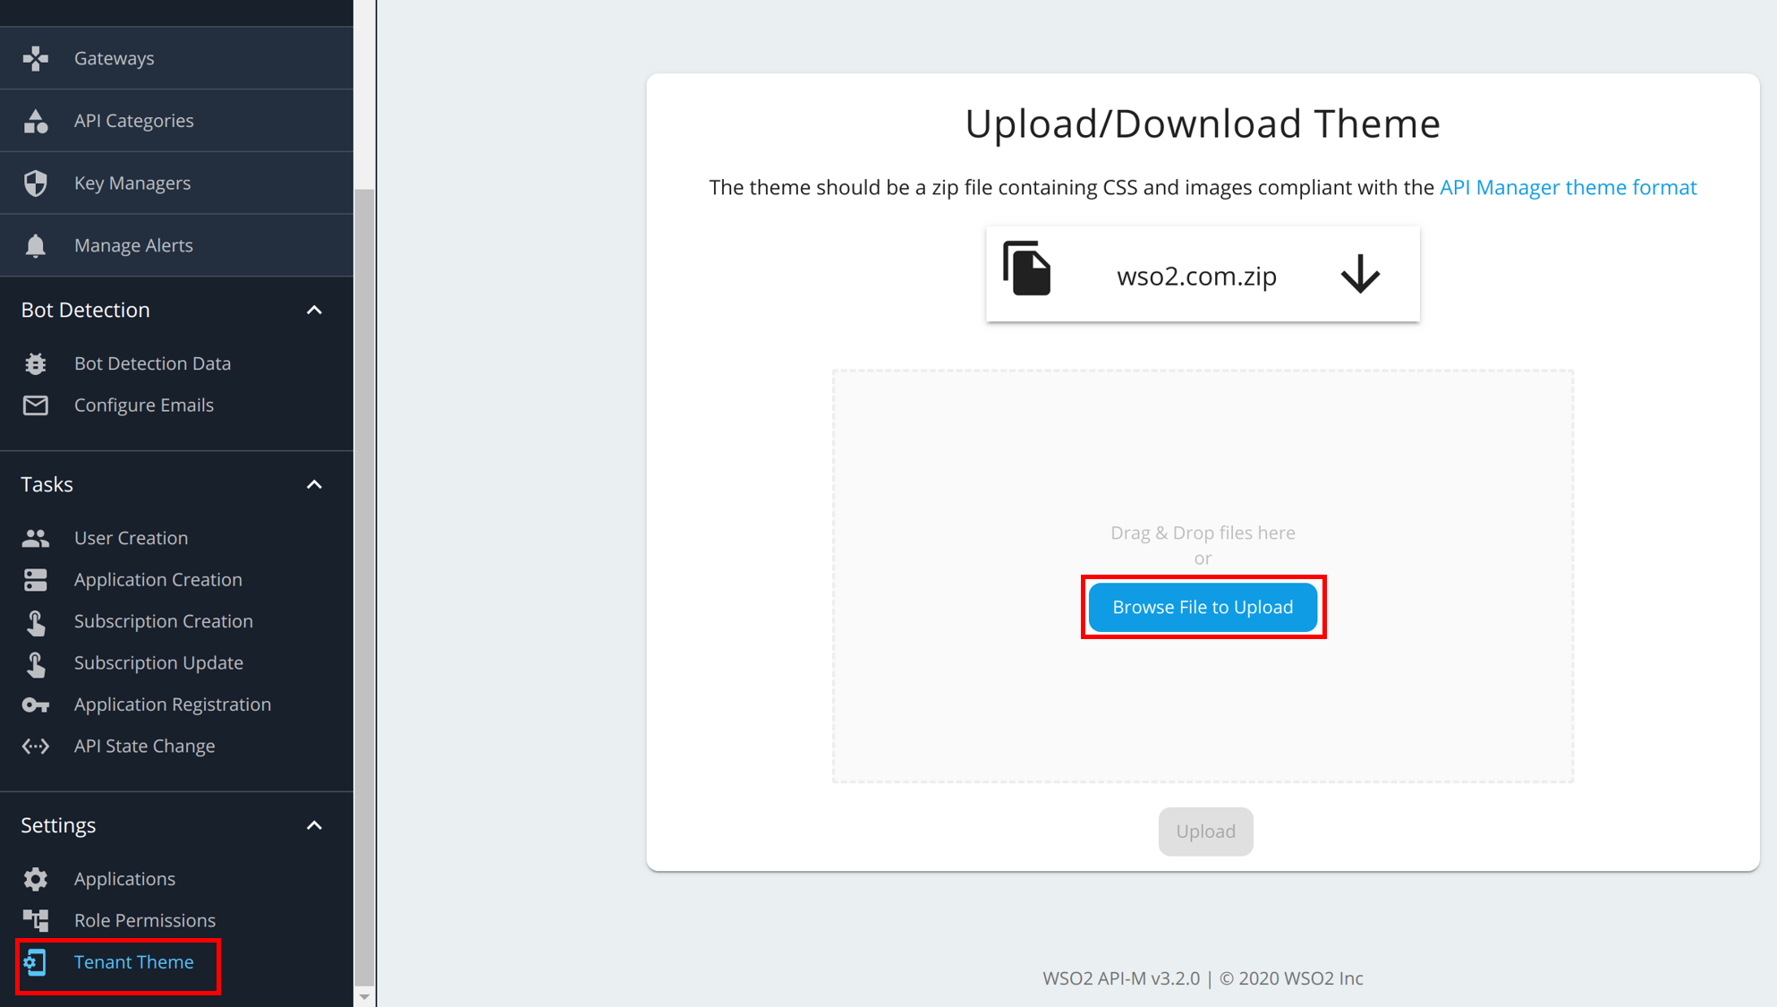
Uploading via the Admin Portal (Tenants only)
The necessary structure to override the theme is as follows,
You can make the changes required to defaultTheme.json file and archive it back. The name of the archive does not matter, but the name of the JSON file (defaultTheme.json) does.
Log in to the Admin Portal and navigate to Settings → Tenant Theme and upload your zip file.
Uploading via the Admin Portal

Slide 6
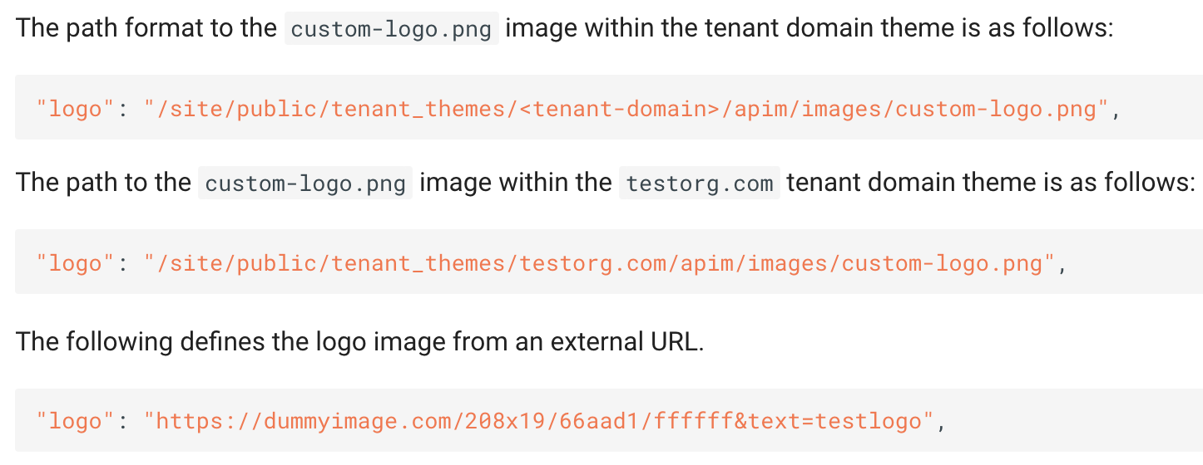
Adding a Custom Logo for the Tenant
Adding a Custom Logo for the Tenant

Slide 7
Applying the CSS Rules to Change the Look and Feel
If you prefer to change the styling using CSS rules, you can use the custom.css file
Note that we have injected IDs into the dom elements. You can use them to apply CSS rules.
However, be aware about the dynamically generated CSS class names. These class names have a number of suffixes which change from version to version. Therefore, it is recommended not to use them for styling purposes.
Applying CSS Rules

Slide 8
Categorizing and Grouping APIs

Slide 9
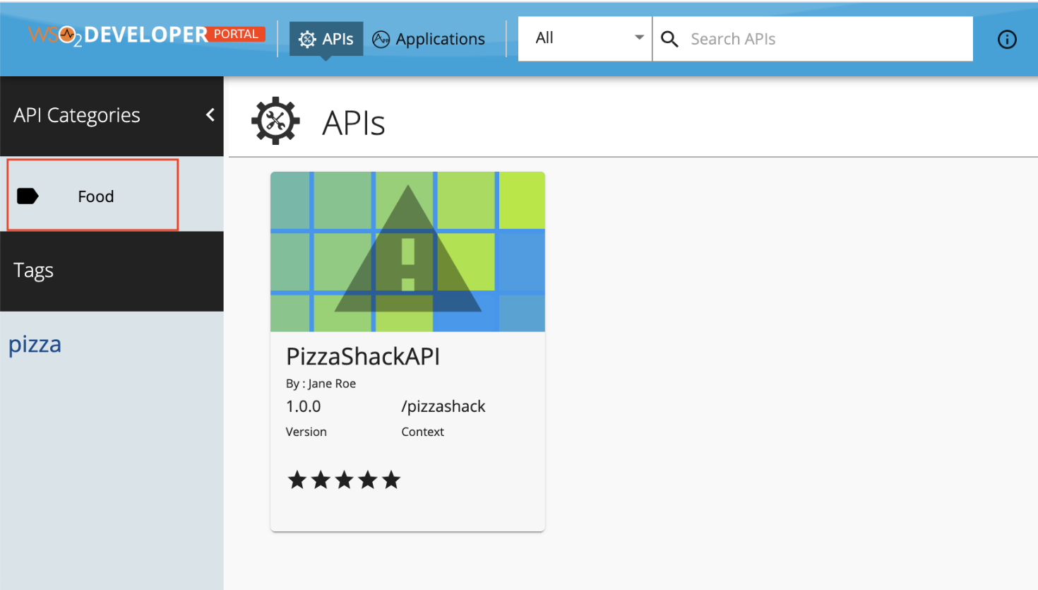
Categorizing and grouping APIs
API providers assign categories to APIs when designing them using the API Publisher.
Tags allow API providers to group APIs that have similar attributes.
When a categorized API gets published to the API Developer Portal, its category appear as clickable links to the API consumers, who can use them to quickly jump to a category of interest.
Categorizing and Grouping APIs

Slide 10
Configure UI Components

Slide 11
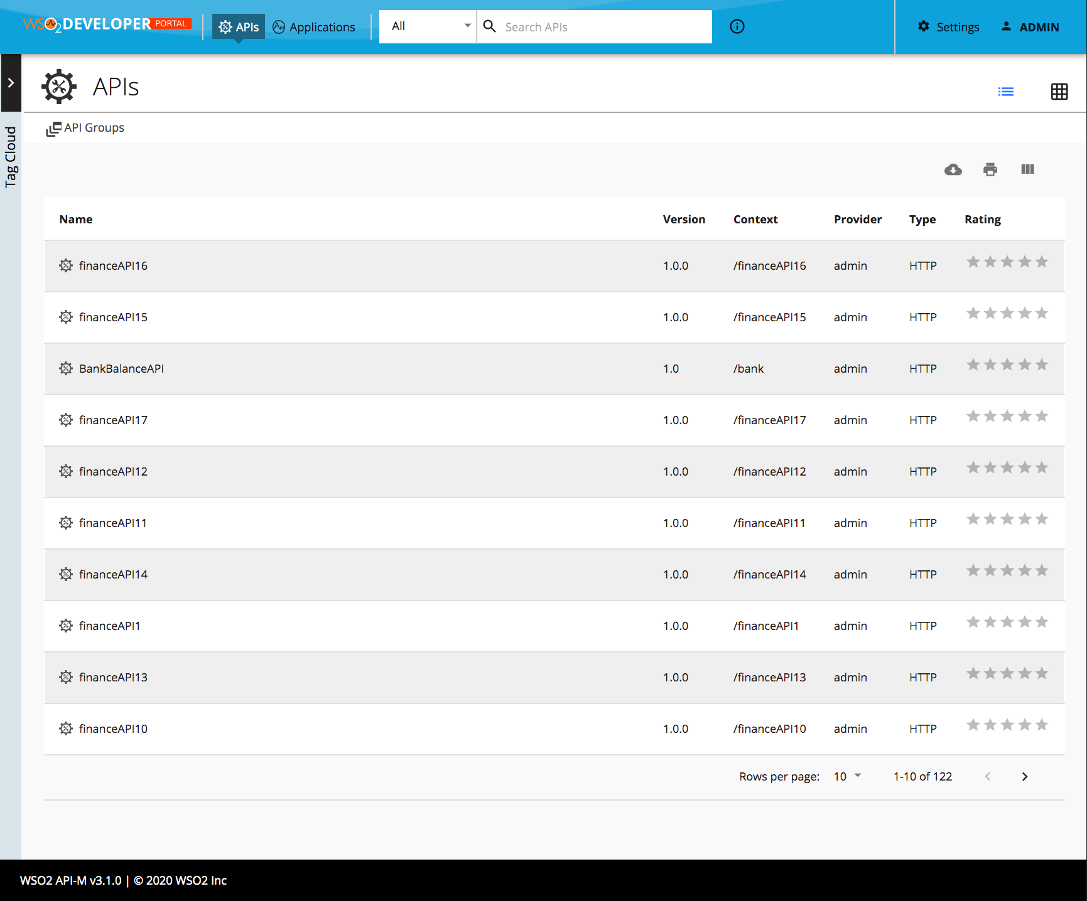
Change the Default View
By default the API Listing view is a grid view.
If you want to change it to listing do the following change in the userTheme.json
{
"custom": {
"defaultApiView" : "list"
}
}
Change the Default View

Slide 12
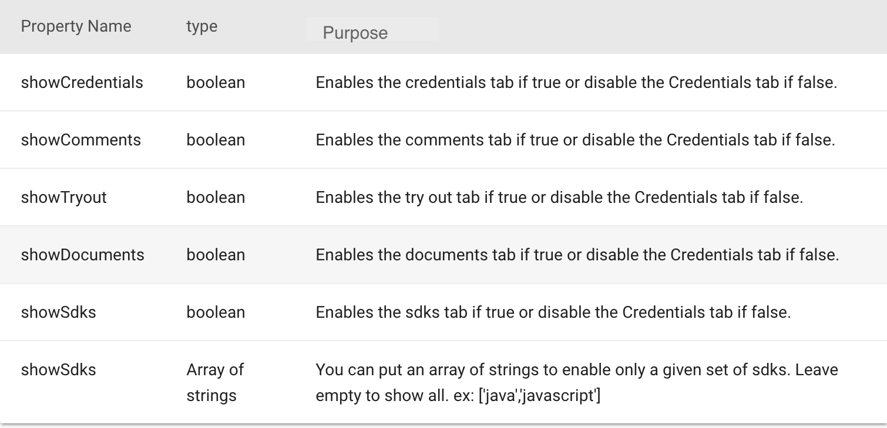
Enabling or Disabling API Details Tab
When you go to the API details page all the links (credentials, comments, tryout, sdks, documents) tabs are displayed. You can enable or disable them by configuring the userTheme.json.
{
"custom": {
"apiDetailPages": {
"showCredentials": false,
"showComments": true,
"showTryout": true,
"showDocuments": false,
"showSdks": false,
"onlyShowSdks": []
}
}
}
Enabling or Disabling API Details Tab

Slide 13
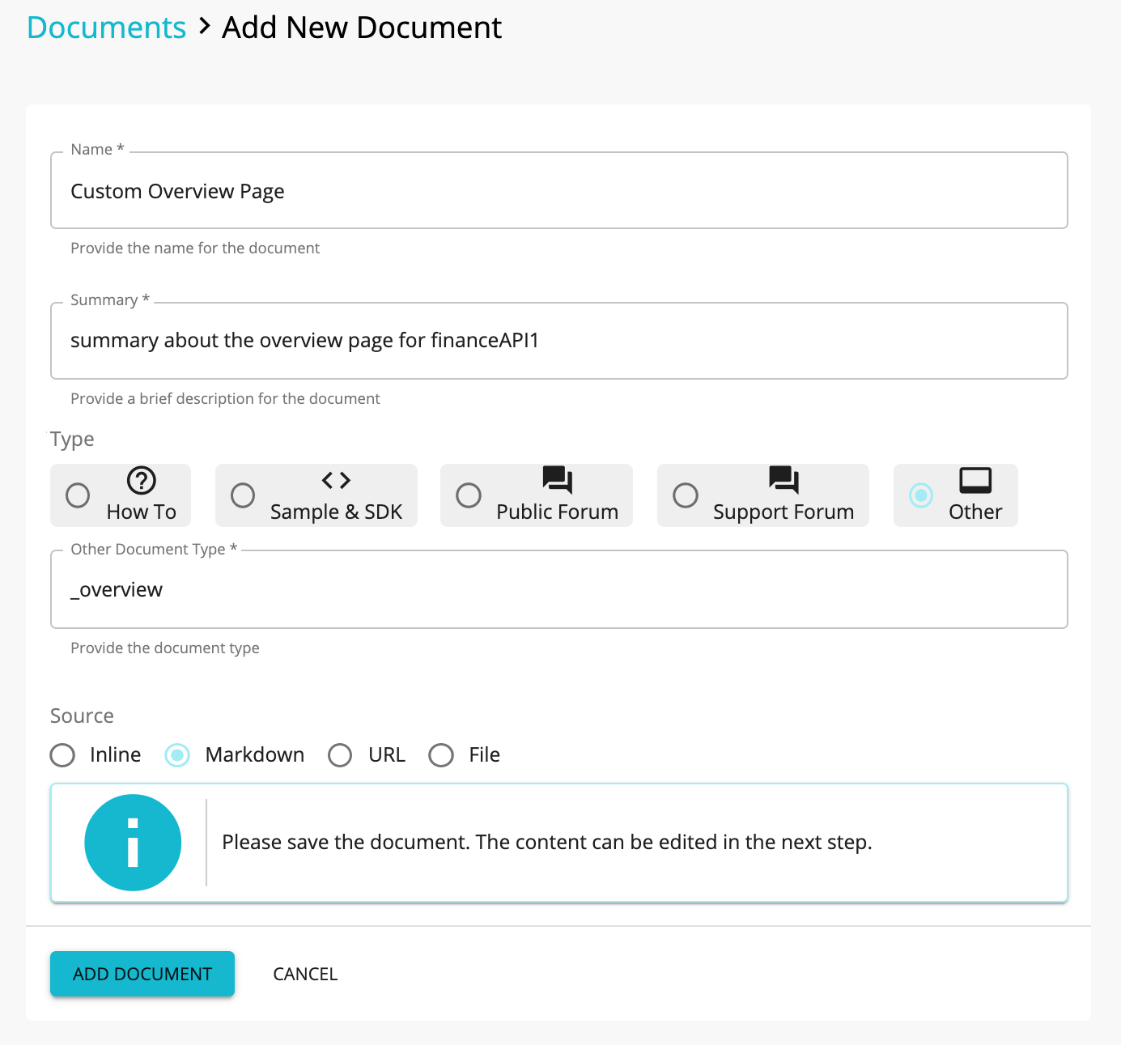
Override API Overview Page per API
It is possible to display custom overview content for any API by adding a document.
Log in to API Publisher and go to the Documents tab of the API you want to override.
Create a new document with the following settings.

Slide 14
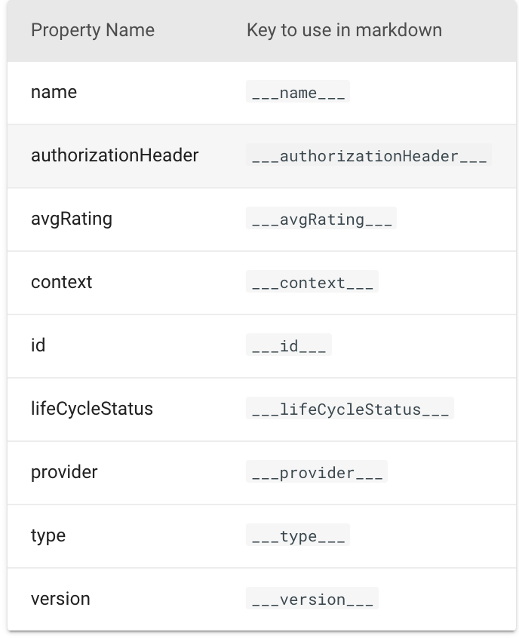
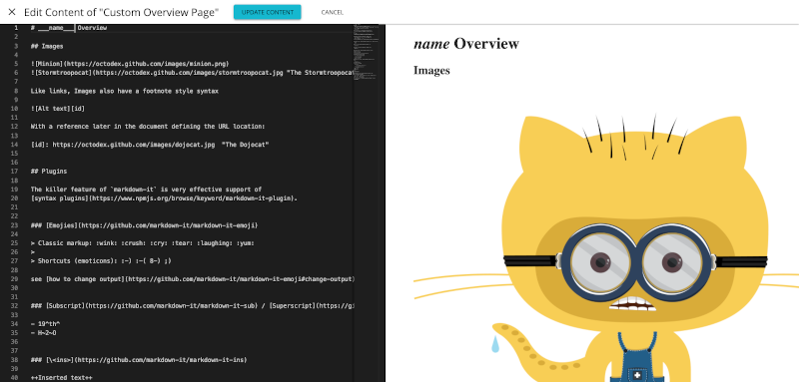
Following keys can be used within the markdown to get some of the API properties.
The above screen demonstrates the use of the name key to display the API name within the markdown content.

Slide 15
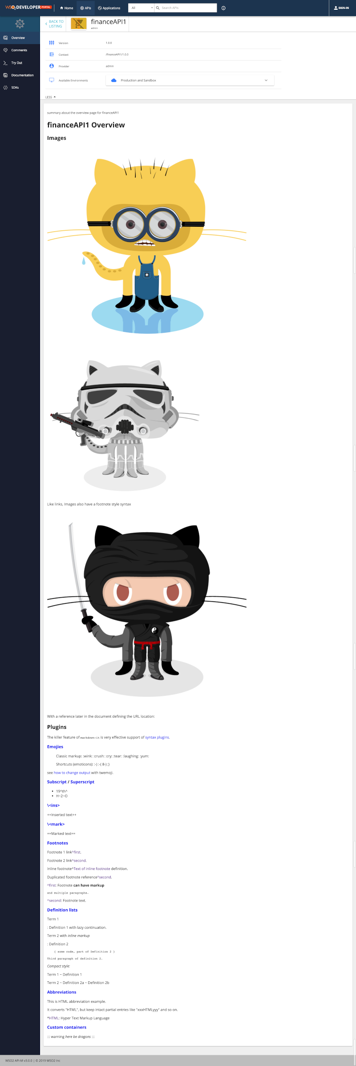
Override Overview Page per API

Slide 16
Enabling/ Disabling Features
Feature | Property | Value
Rating | social: { showRating: false, }, | true / false
Home Page | landingPage: { active: true, }, | true / false
Tag Cloud | tagCloud: { active: true, }, | true / false
Footer | footer: { active: true, }, | true / false
Banner | banner: { active: true, }, | true / false

Slide 17
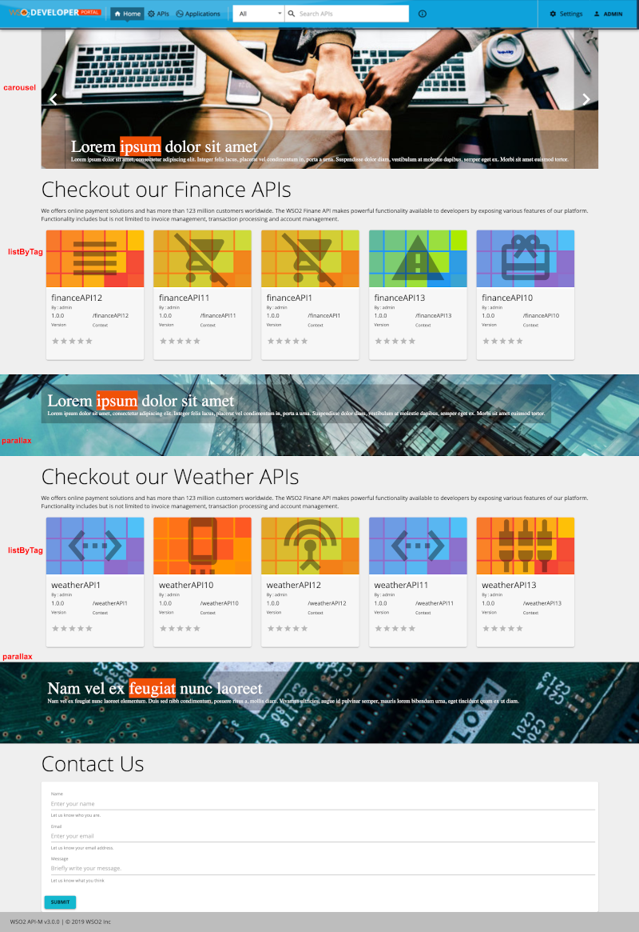
Enabling the Home Page
The home page has 4 sections.
Carousel
First description and the listing of APIs filtered by a given tag ( provided via the theme file )
Second description and the listing of APIs filtered by a given tag ( provided via the theme file )
Contact us section
Enable or Disable the Home page

Slide 18
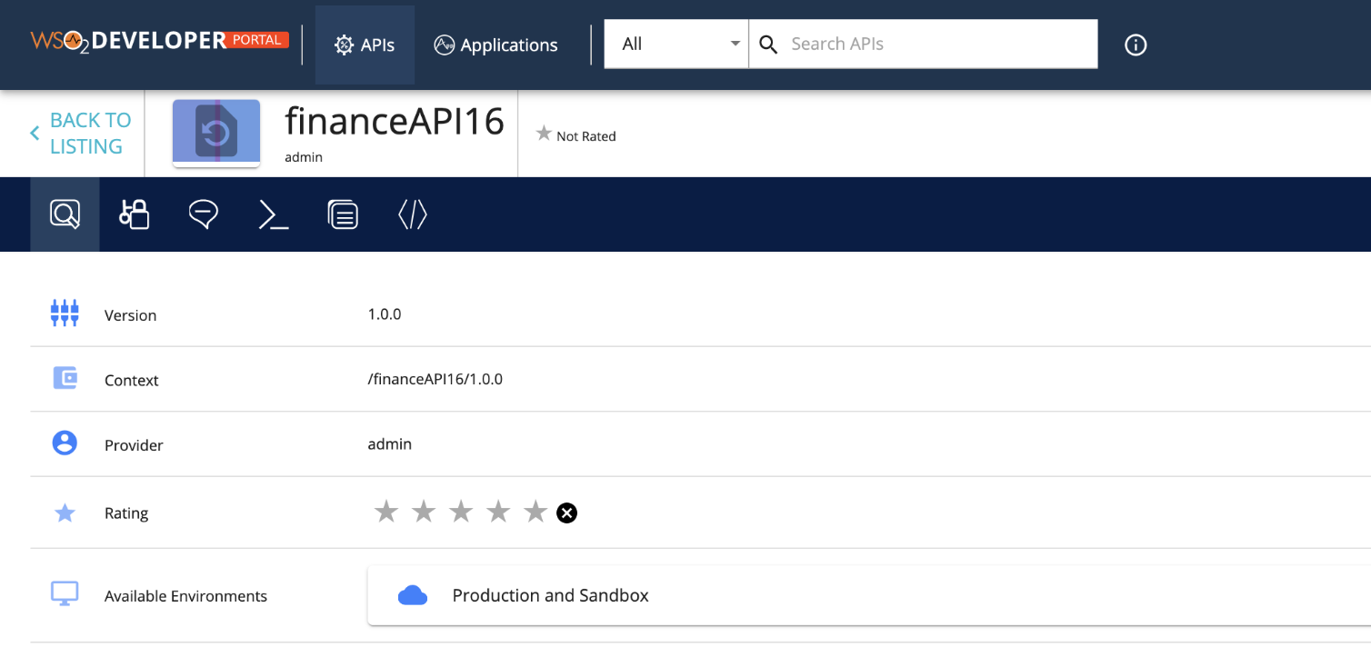
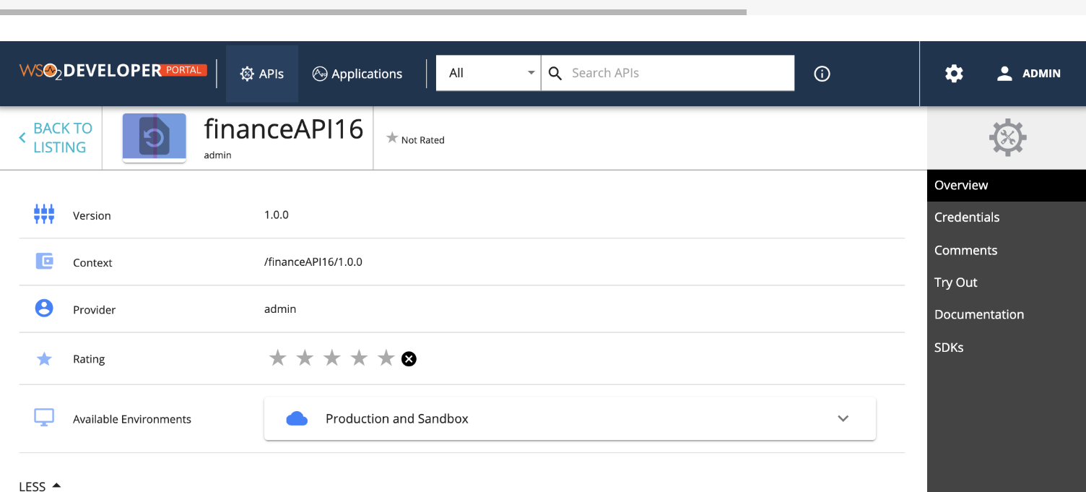
Styling API Details Left Menu
You can change the leftMenu attributes to change the styling of the left menu.
Styling API Details Left Menu

Slide 19
Styling the Logo and Header
We can change the logo and header background as follows by changing the below parameters.
{
"custom": {
"appBar": {
"logo": "/site/public/images/logo-black.png",
"logoHeight": 66,
"logoWidth": 200,
"background": "#a10207",
"activeBackground": "#ffd500"
}
}
}
Styling the Logo and Header Styles

Slide 20
Enabling or Disabling Self-signup
In a multi-tenanted API Manager setup, self signup to the Developer Portal is not enabled by default to all tenants. This will work out-of-the-box for super tenant (carbon.super).
But in order to make it work for tenants, follow the configurations in,
Enabling Self Signup
Disabling Self Signup

Slide 21
Advanced Customizations

Slide 22
Advanced Customization
NodeJS is the platform needed for the ReactJS development.
The devportal user interface can be customized simply without updating the React codebase or CSS for most common cases. But for advanced use cases, it is required to modify the react code base.
The react applications of API Manager are hosted in jaggery apps.
The distribution can be found in repository/deployment/server/webapps/devportal/site/public/dist folder.
The API Manager distribution ships the React code base with it. You can find the source code in repository/deployment/server/webapps/devportal/source folder.
Advanced Customization

Slide 23
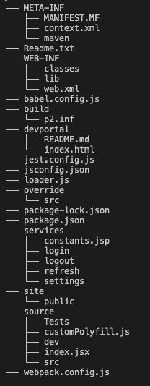
The file structure of the code base of the Developer Portal is as follows,
File | Purpose
babel.config.js | Includes the supported browser versions.
override | Folder to override a particular React component
package.json | Contains a list of all the dependencies which are used in the project
package-lock.json | package-lock.json is automatically generated for any operations where npm modifies either the node_modules tree, or package.json
services | Includes the login, logout and introspection calls
site | Includes css files, fonts, images, themes and pages
source | Includes the react files of the project

Slide 24
How to Override
Extract the source code.
Navigate to repository/deployment/server/webapps/devportal/src/main/webapp in a terminal and run the following command.
npm ci
Run the following to start the npm build. Note that it will continuously watch for any changes and rebuild the project.
npm run build:dev
If you are planning to completely rewrite the UI, then you can start making changes at devportal/source/.
But if you want to override a certain React component or file from source/src/ folder, you need to do it in devportal/override/src folder. You do not have to copy the entire directory, only copy the desired file/files.

Slide 25
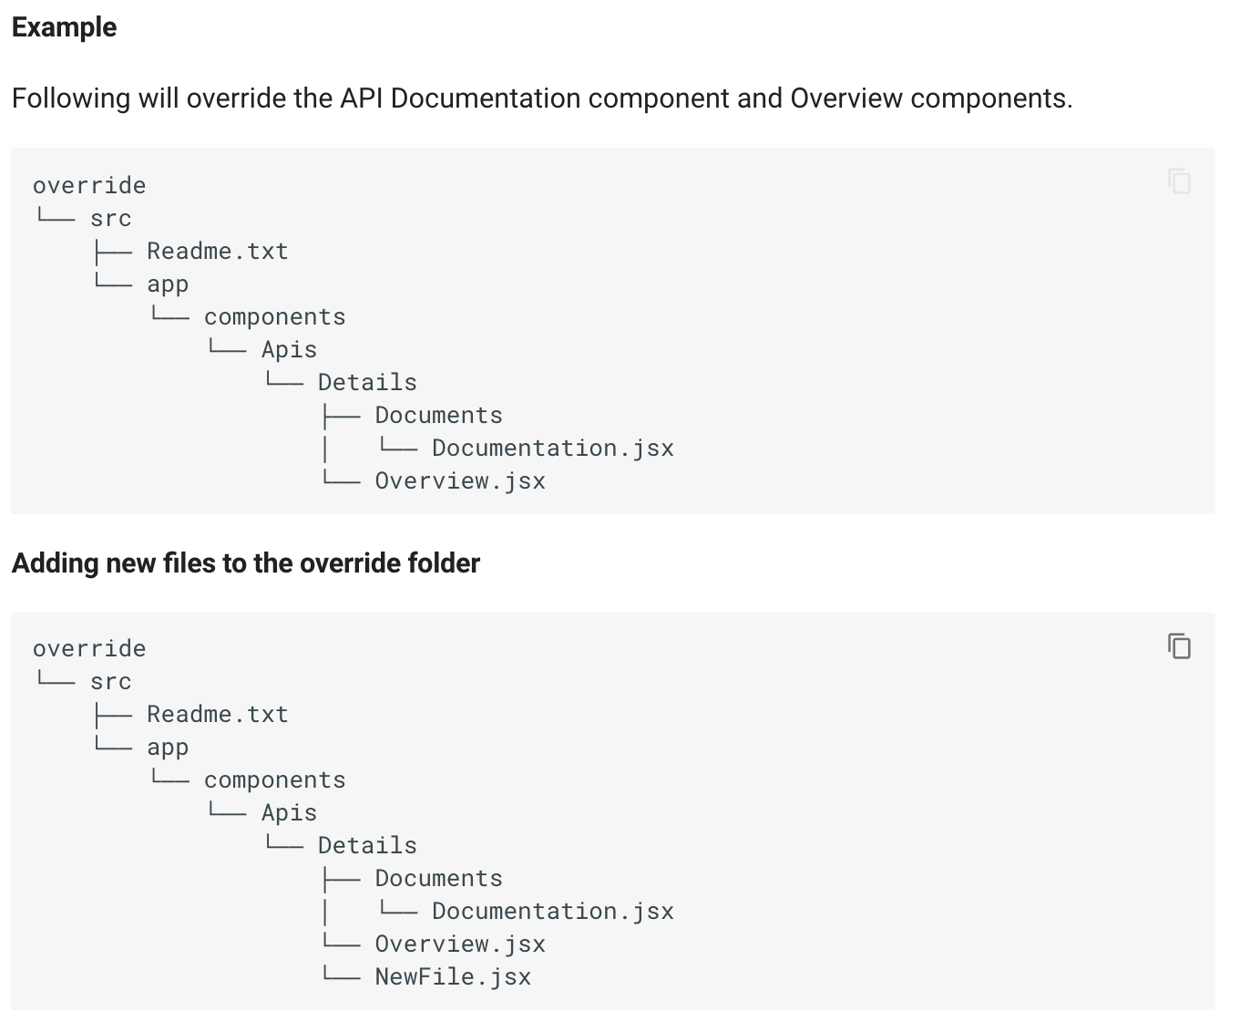

Slide 26
If we try to import the NewFile.jsx from Overview.jsx as follows it will give a compilation error.
import NewFile from './NewFile.jsx';
The correct way is to add the AppOverride prefix to the import and provide the full path relative to the override folder.
import NewFile from 'AppOverride/src/app/components/Apis/Details/NewFile.jsx';
Development
When you are doing an active development, the watch mode is working with the overridden files. But adding new files and directories will not trigger a new webpack build.

Slide 27

Let’s try it out!
Customizing the Developer Portal

